Slide 1
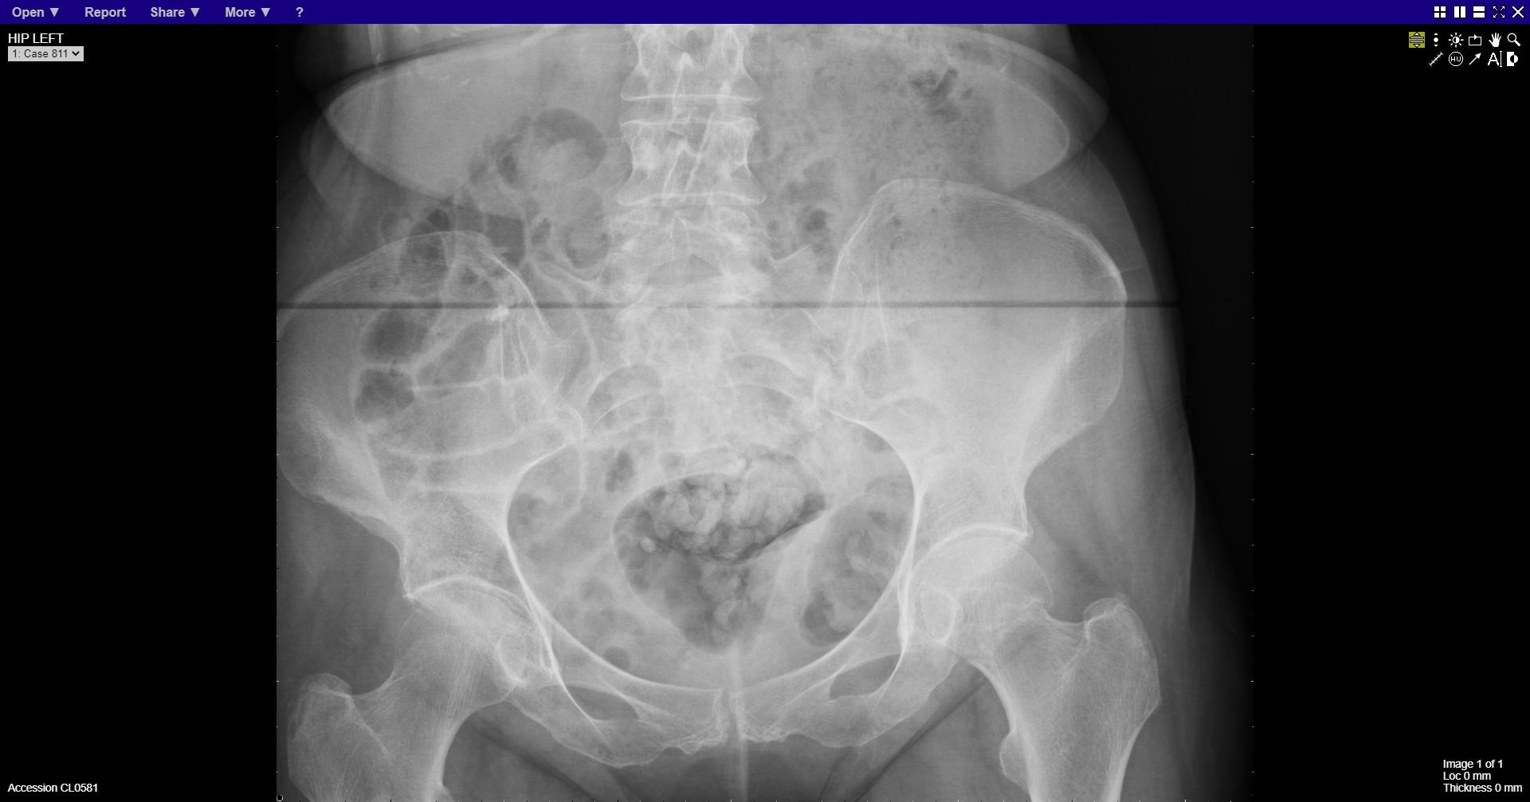
Notes:
Left neck of femur fracture

Slide 2
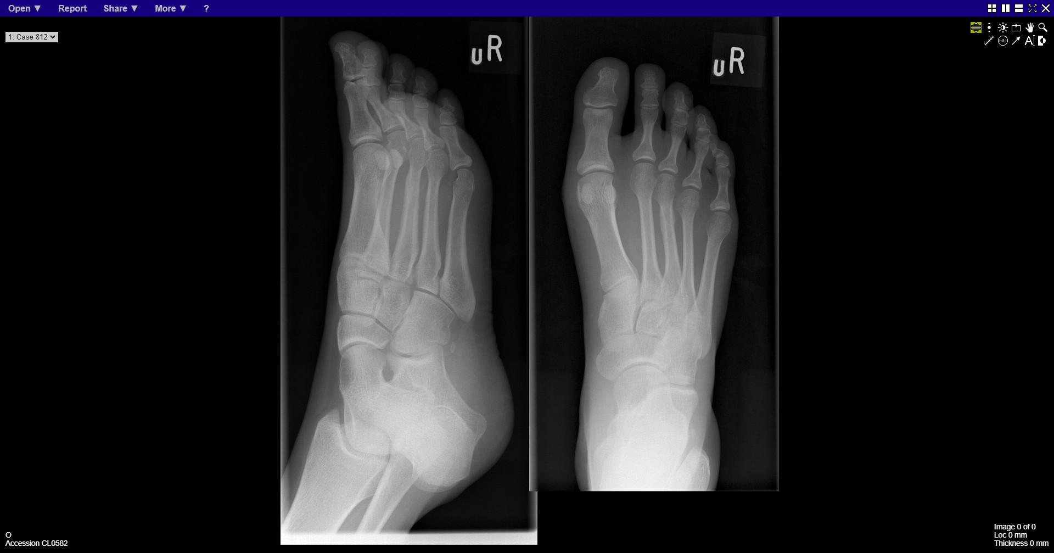
Notes:
Stress fracture 3rd metatarsal

Slide 3
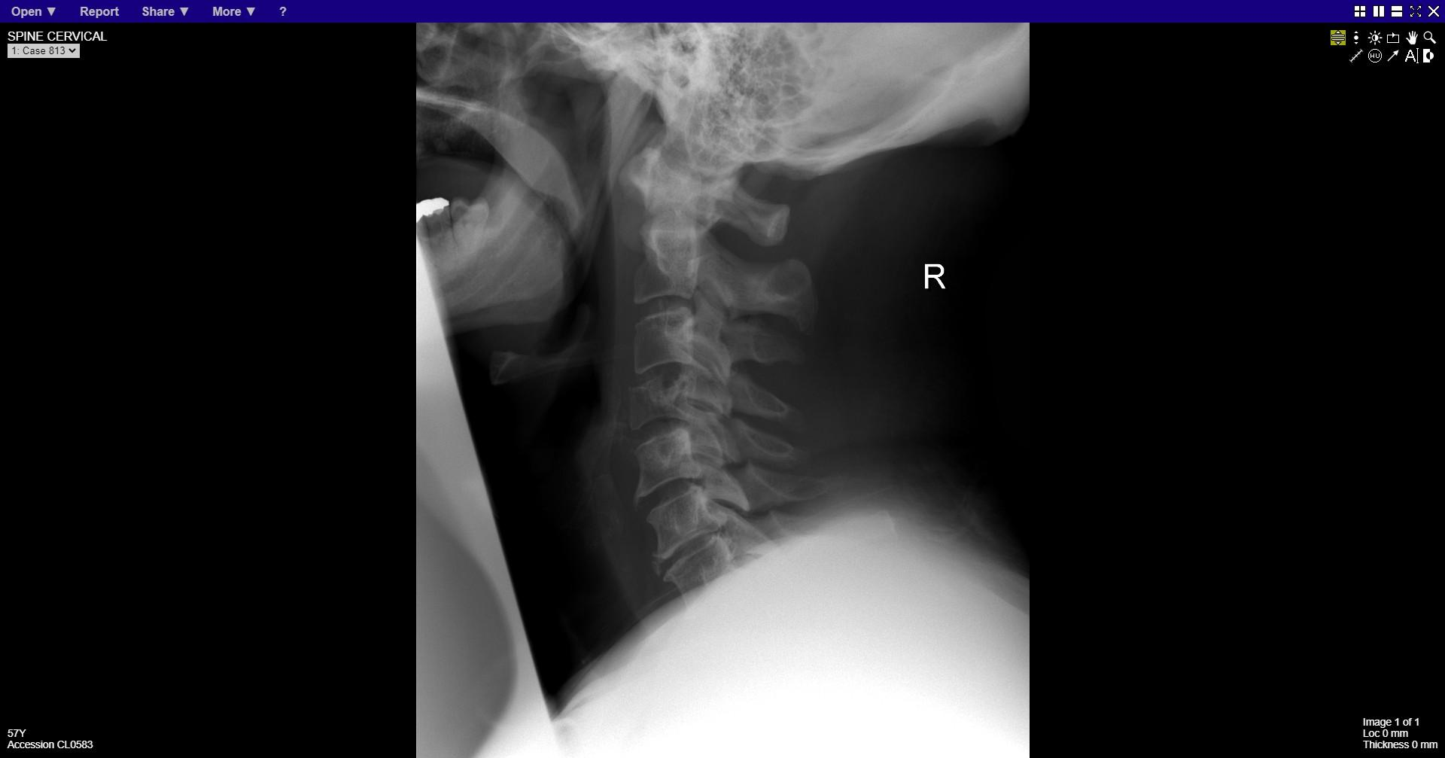
Notes:
Compression fracture C4 vertebral body

Slide 4
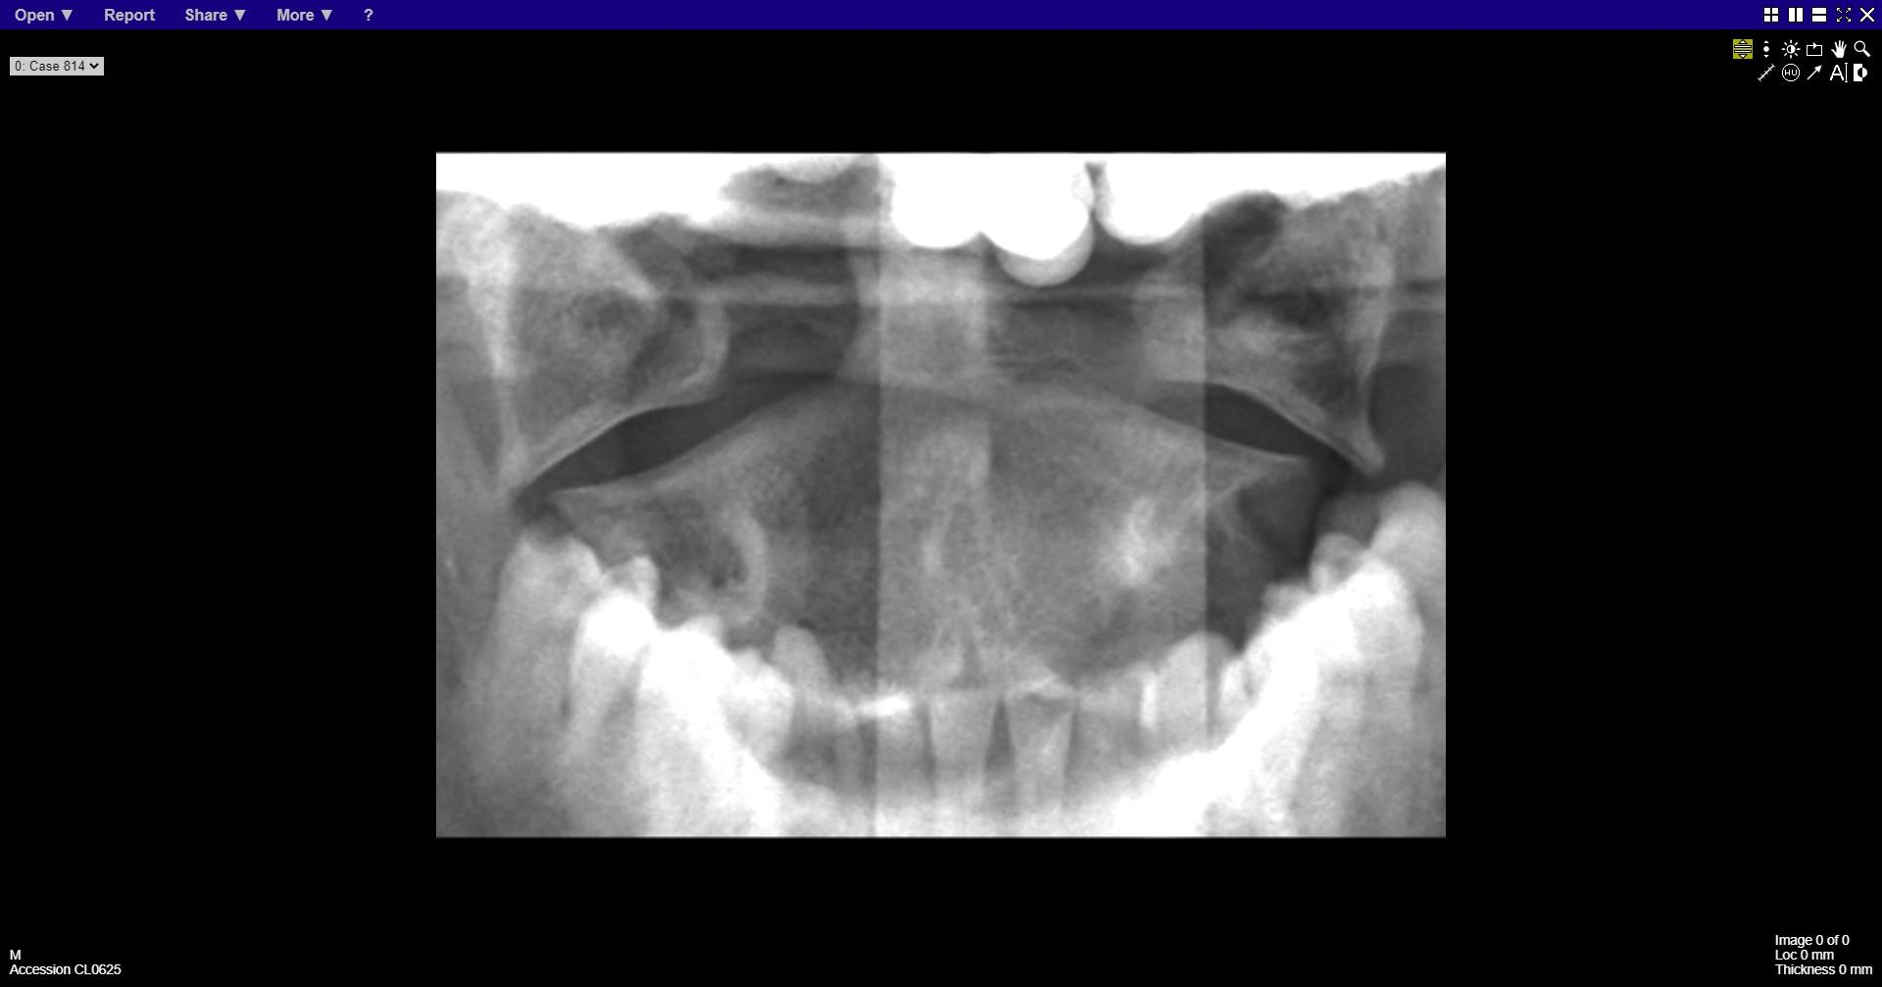
Notes:
C1 burst fracture
aka Jefferson fracture

Slide 5
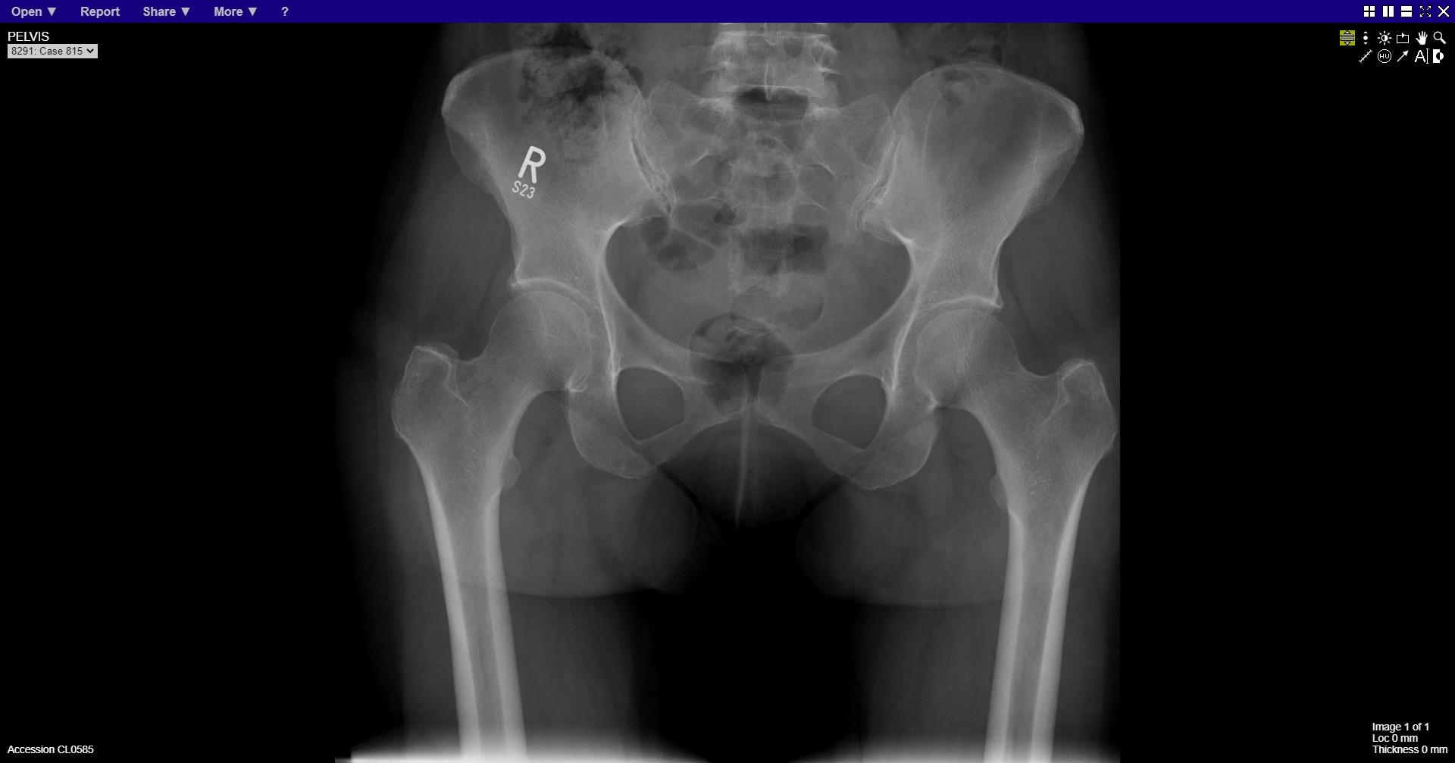
Notes:
normal

Slide 6
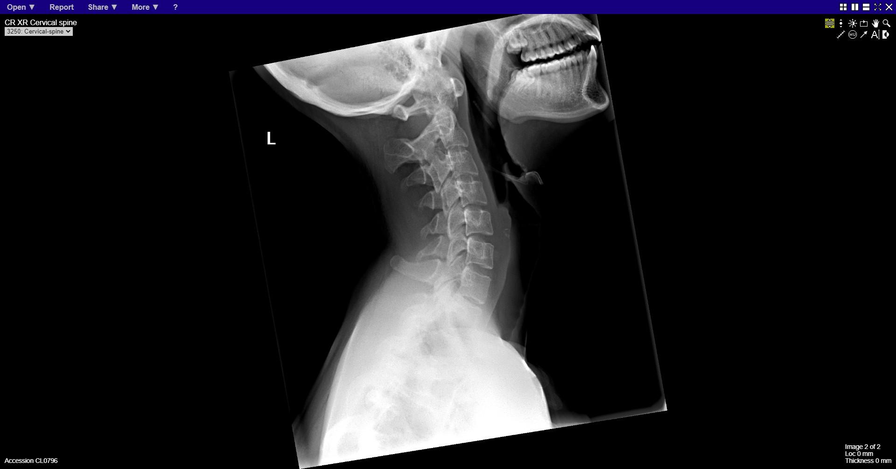
Notes:
Odontoid peg fracture

Slide 7
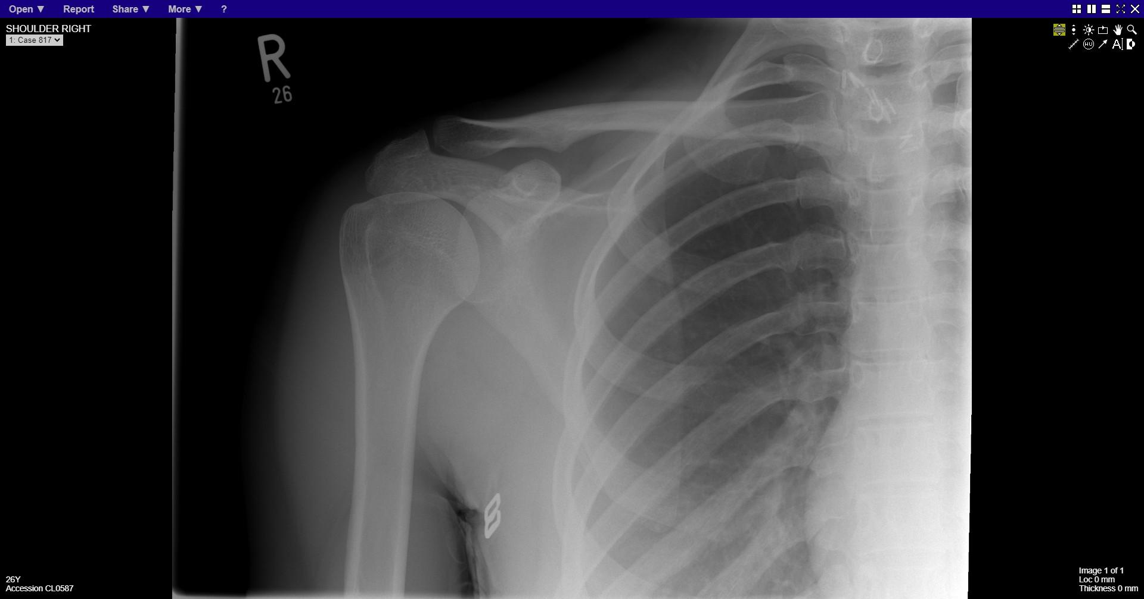
Notes:
Normal
Surgical clips normal

Slide 8
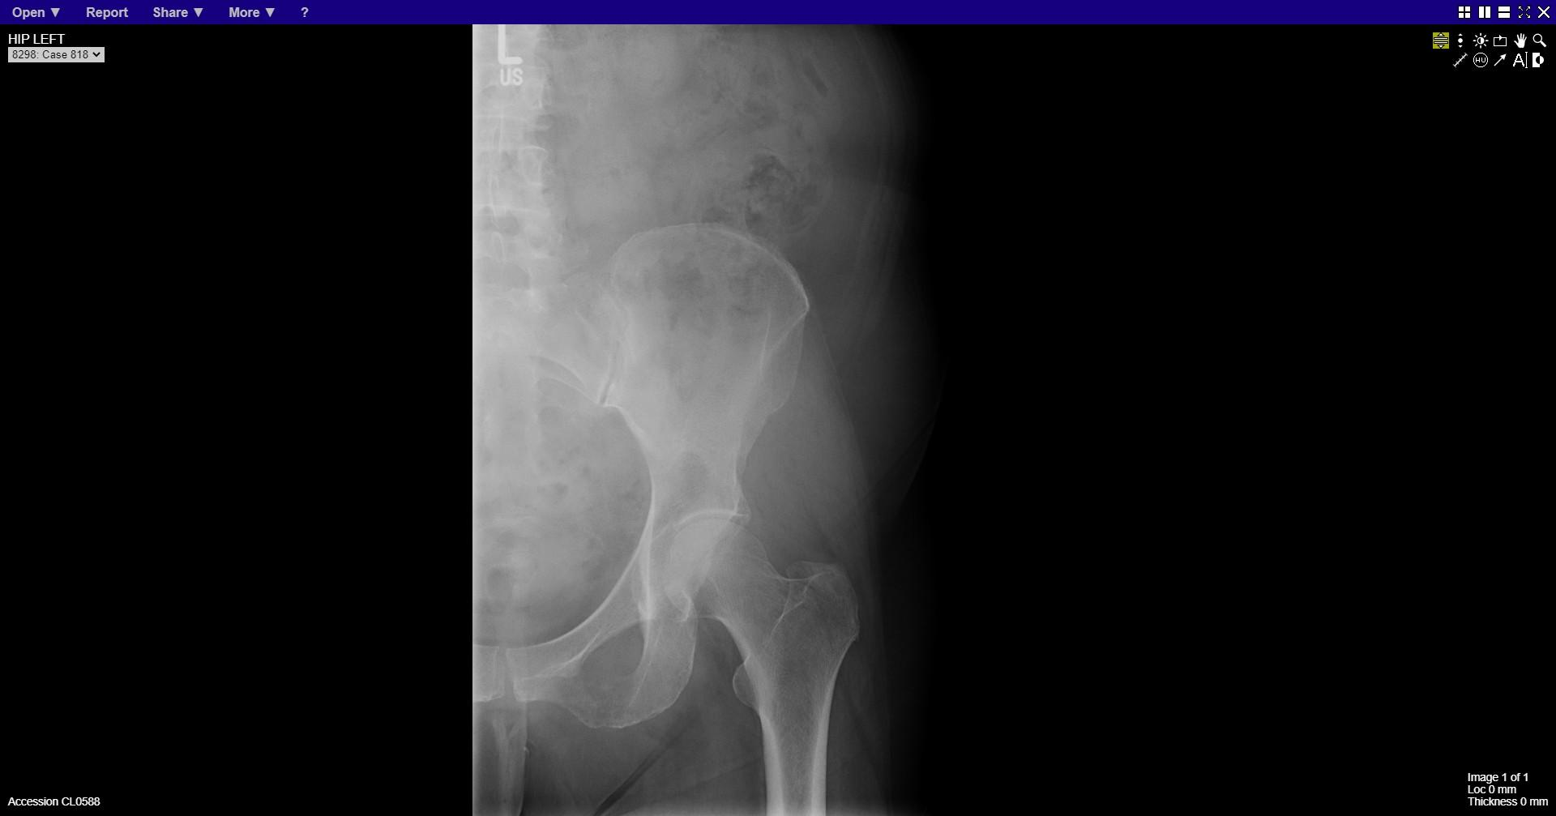
Notes:
Lytic lesion in the inferior pubic ramus

Slide 9
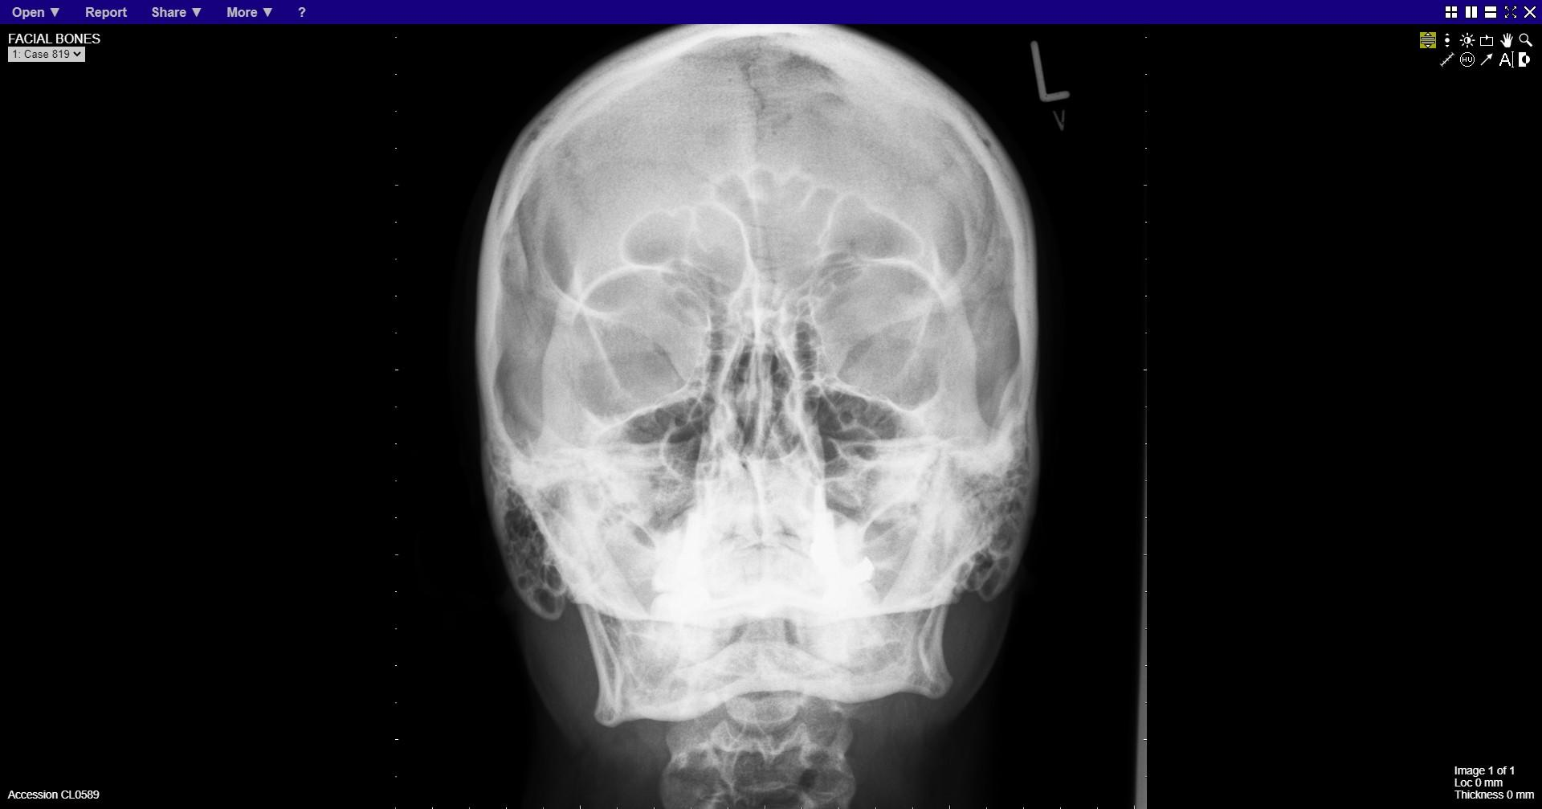
Notes:
normal

Slide 10
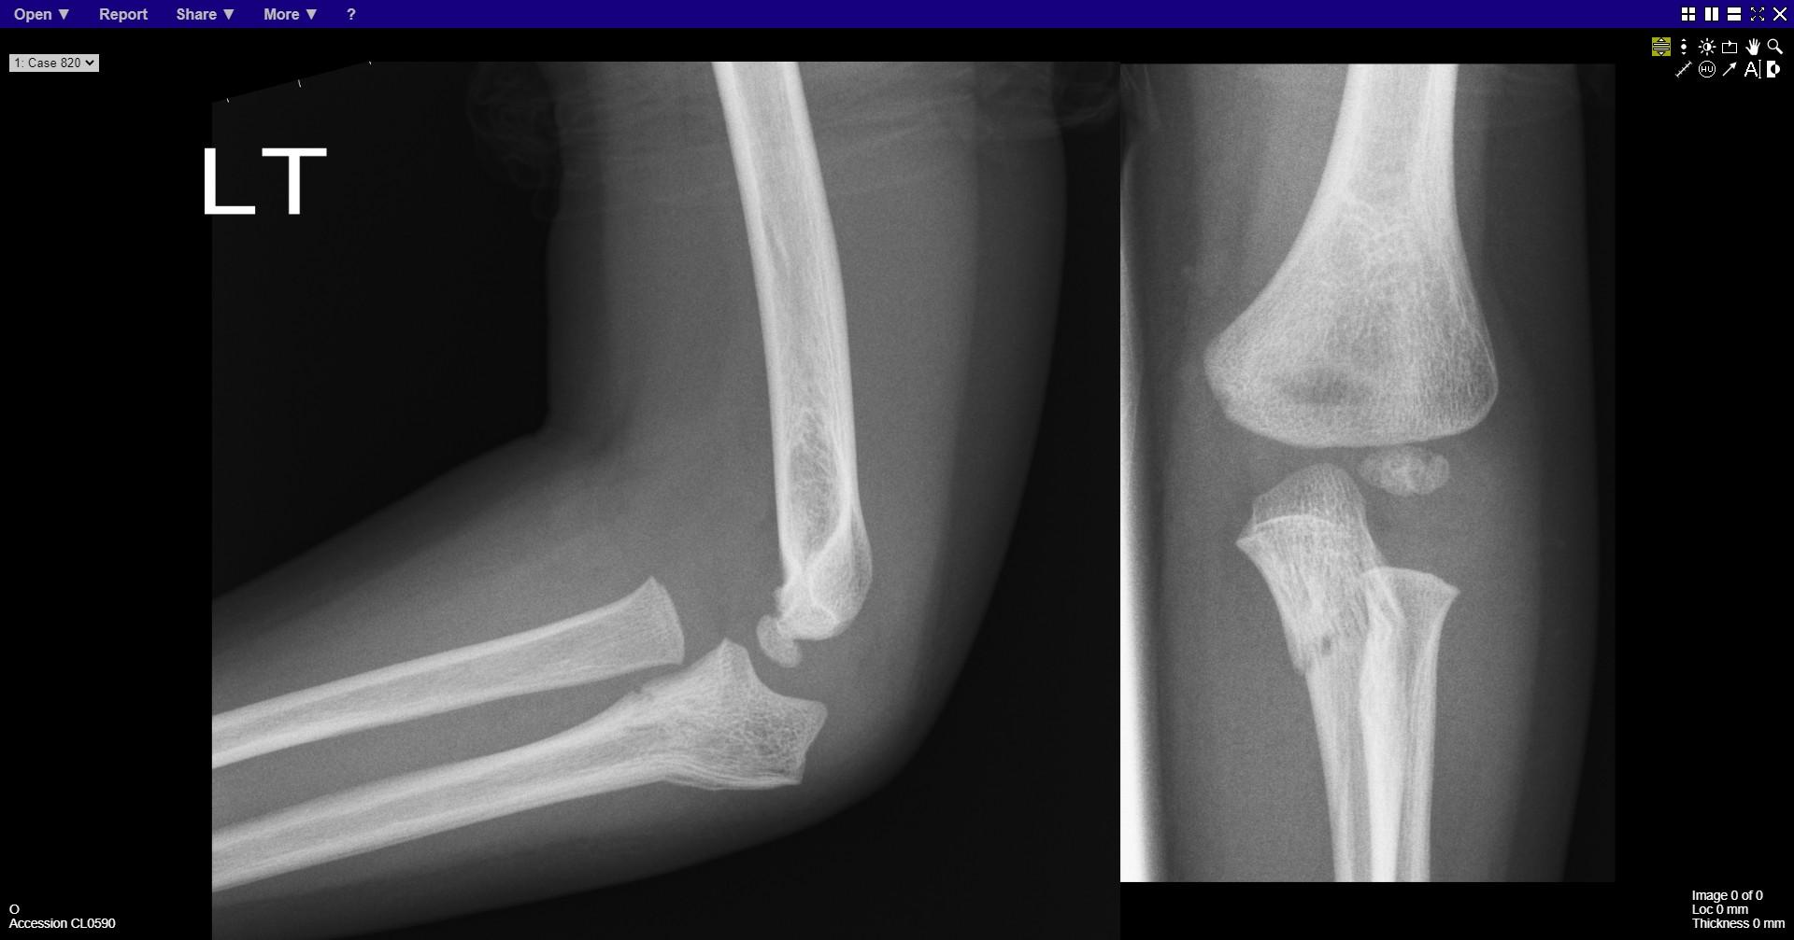
Notes:
Fracture ulna and radial head dislocation

Slide 11
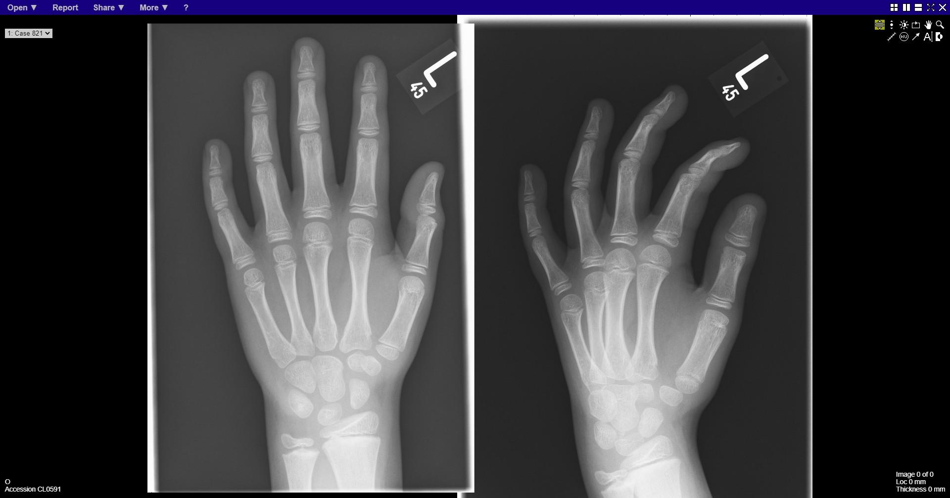
Notes:
normal

Slide 12
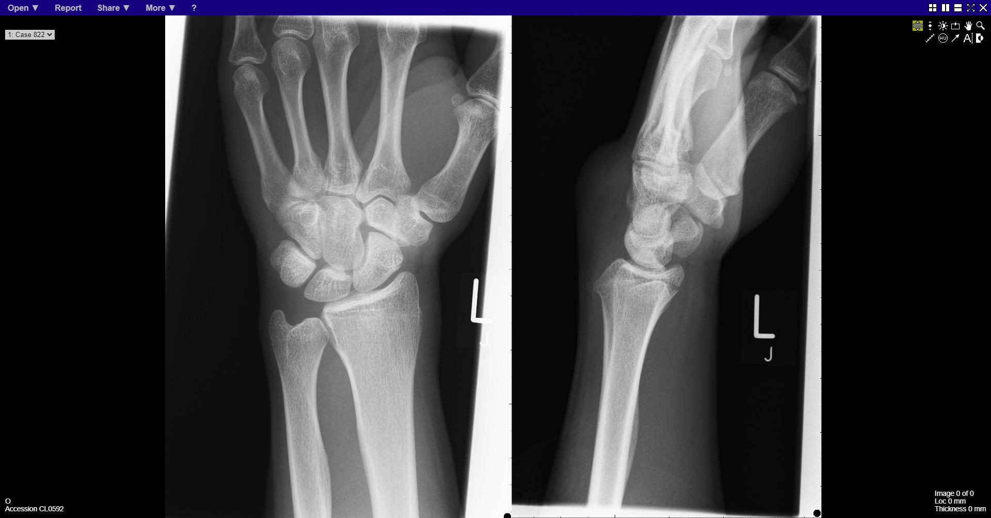
Notes:
Distal radius fracture

Slide 13
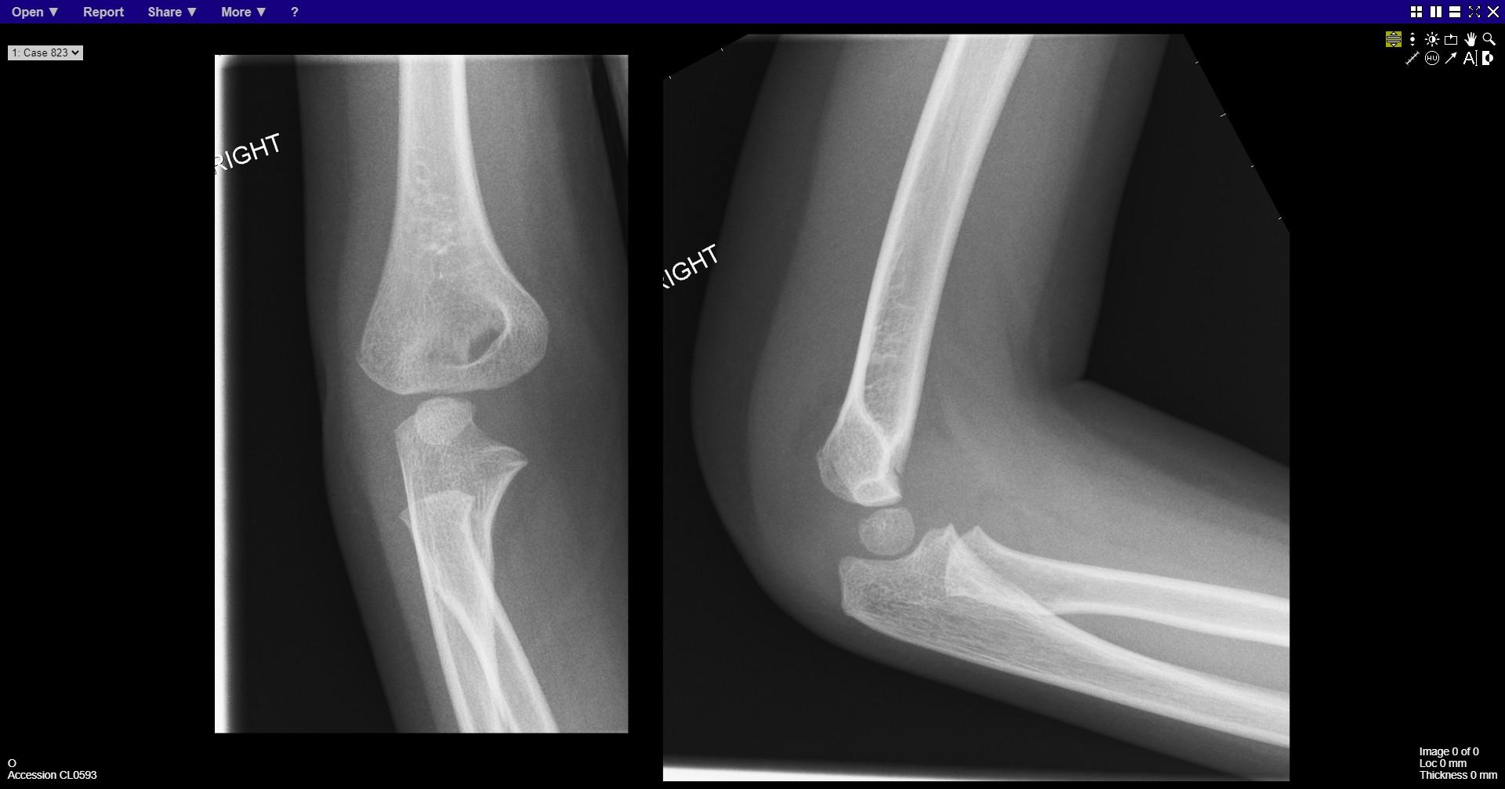
Notes:
Supracondylar fracture

Slide 14
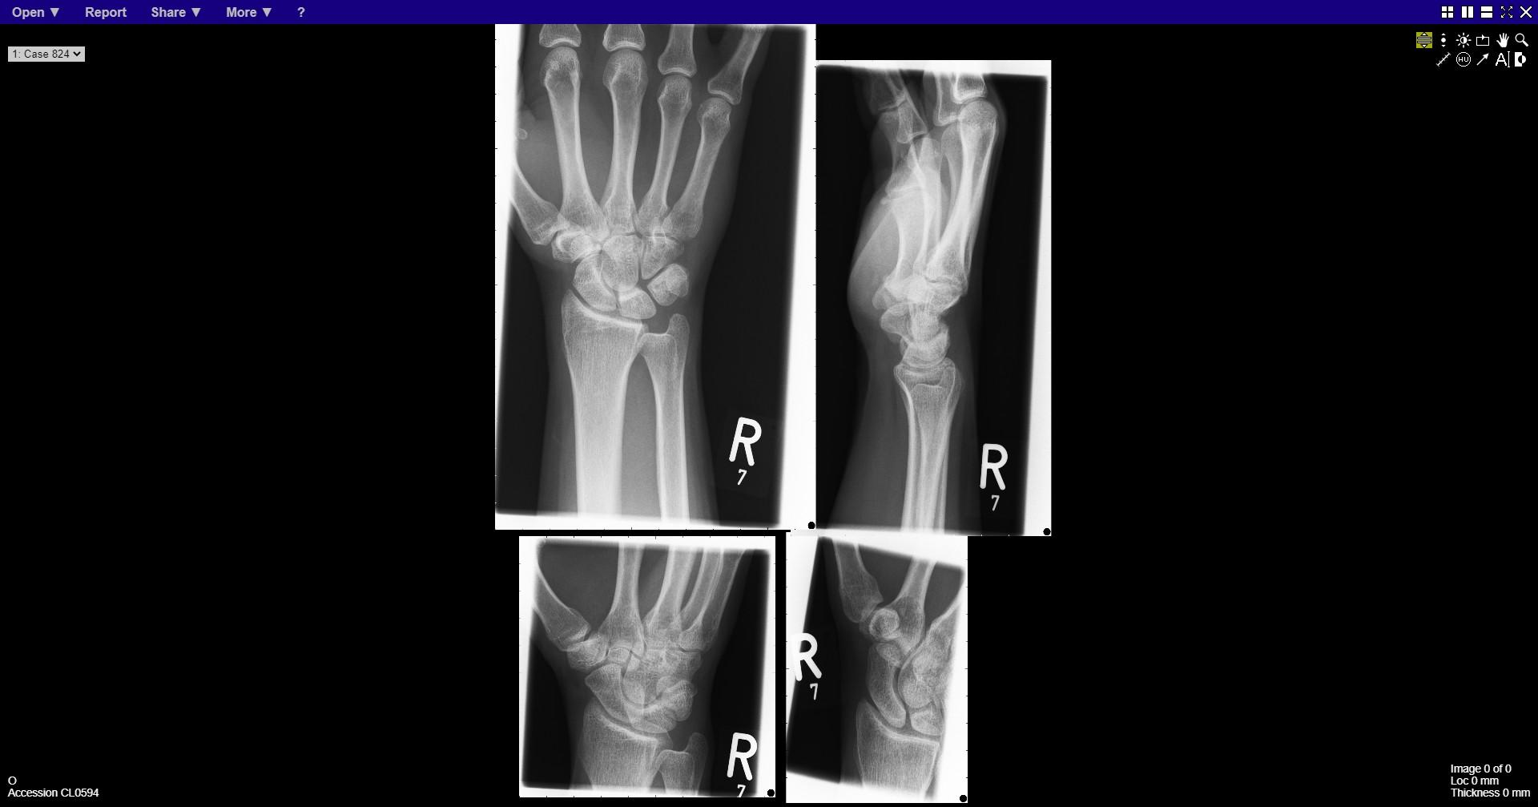
Notes:
normal

Slide 15
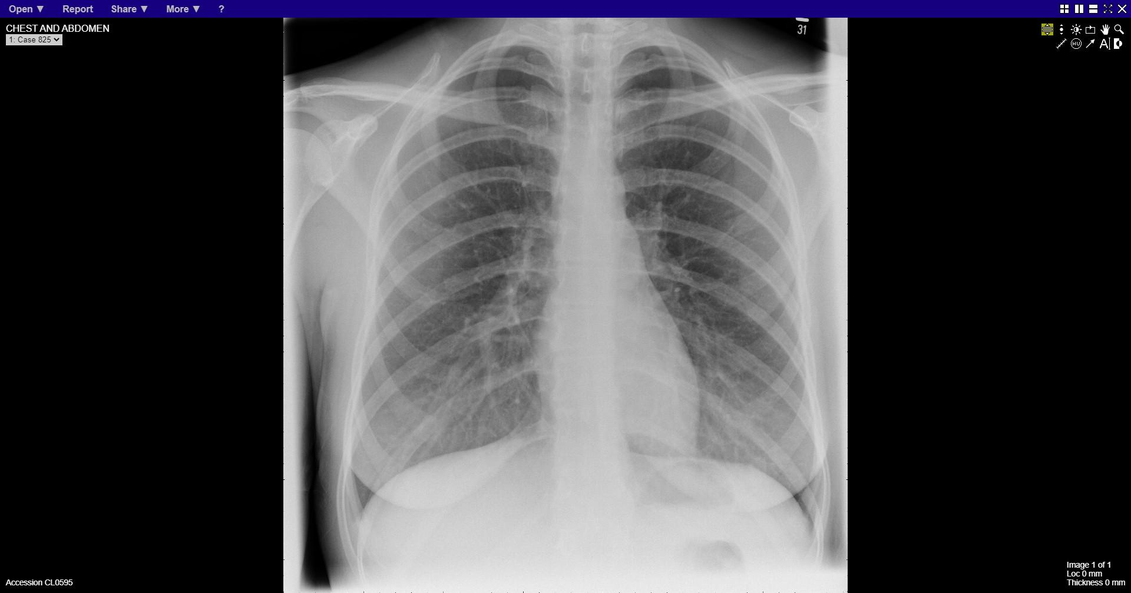
Notes:
normal

Slide 16
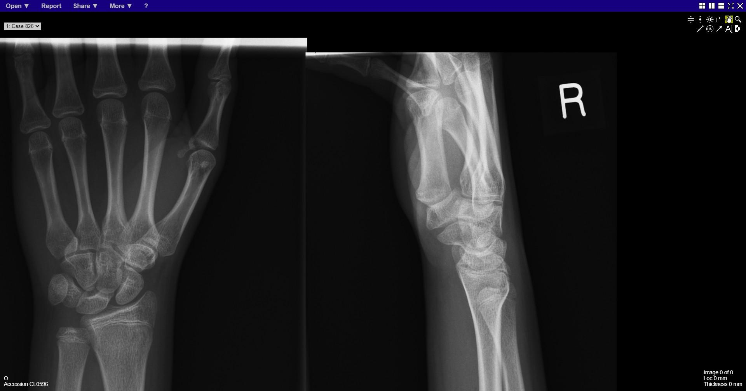
Notes:
Greenstick fracture distal radius

Slide 17
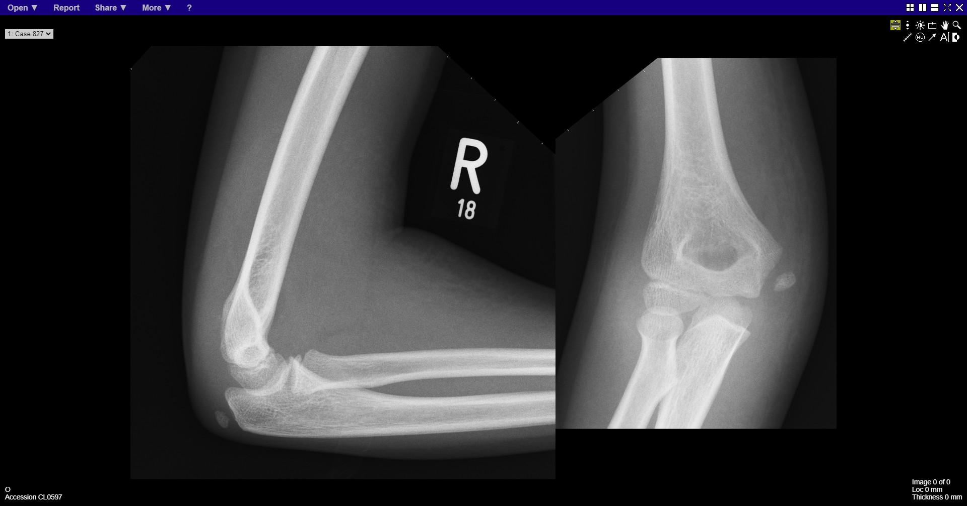
Notes:
Avulsed medial epicondyle

Slide 18
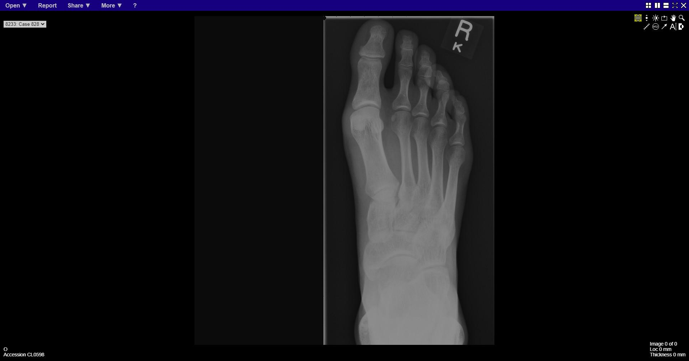
Notes:
normal

Slide 19
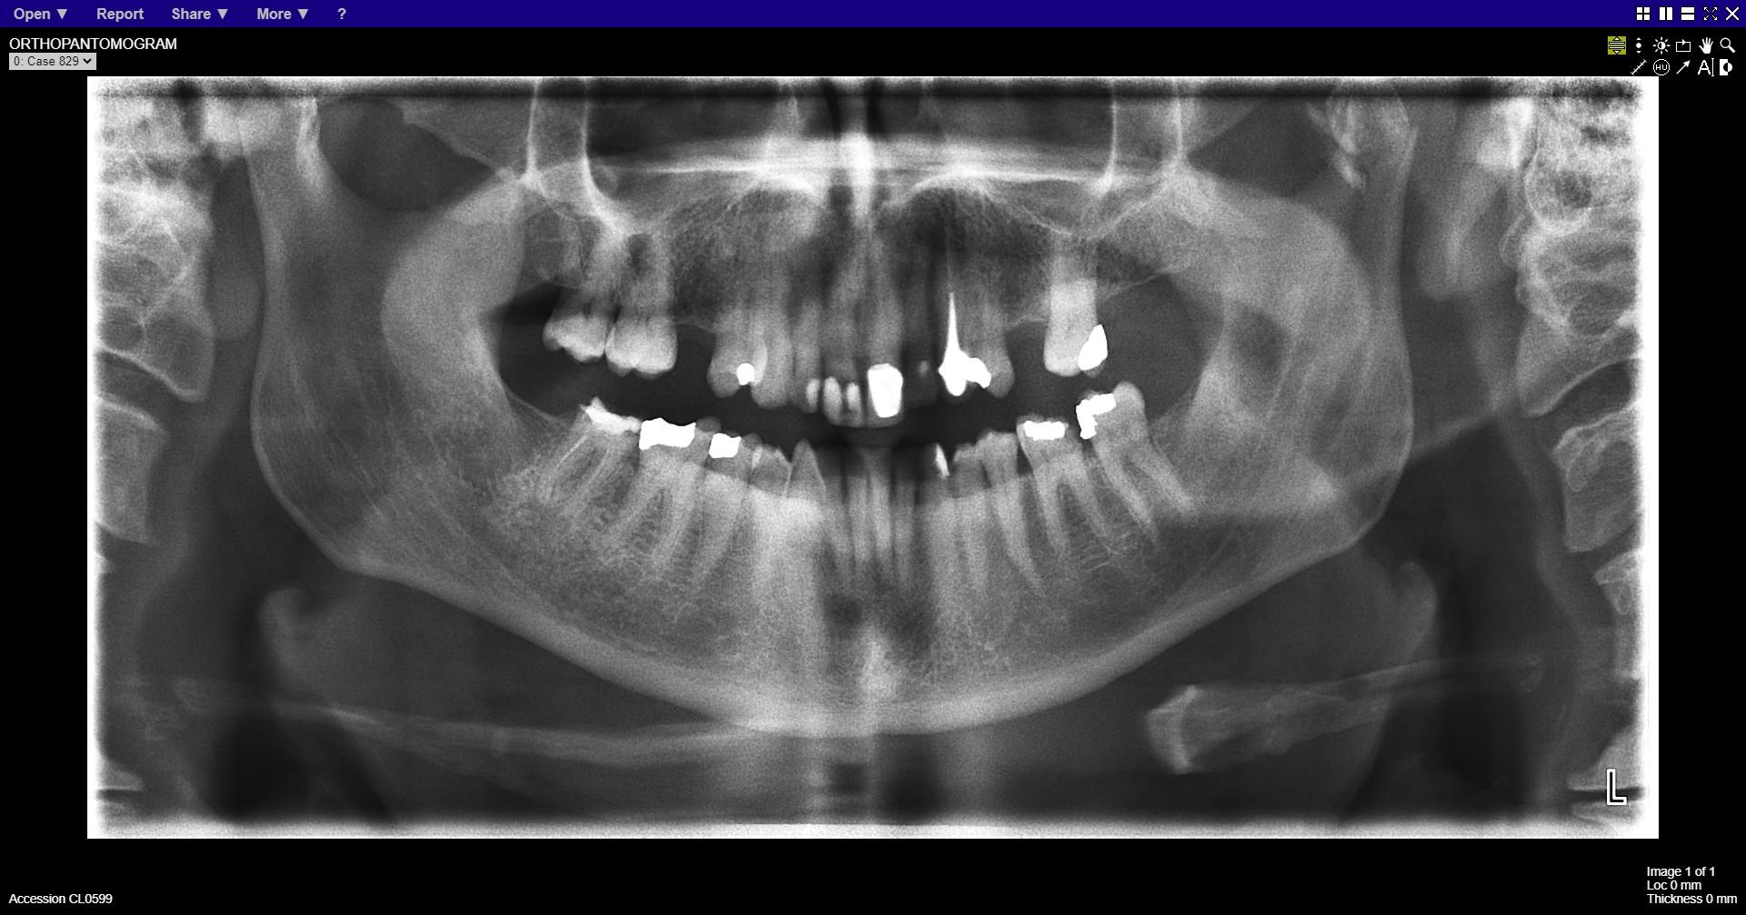
Notes:
Left condylar neck fracture

Slide 20
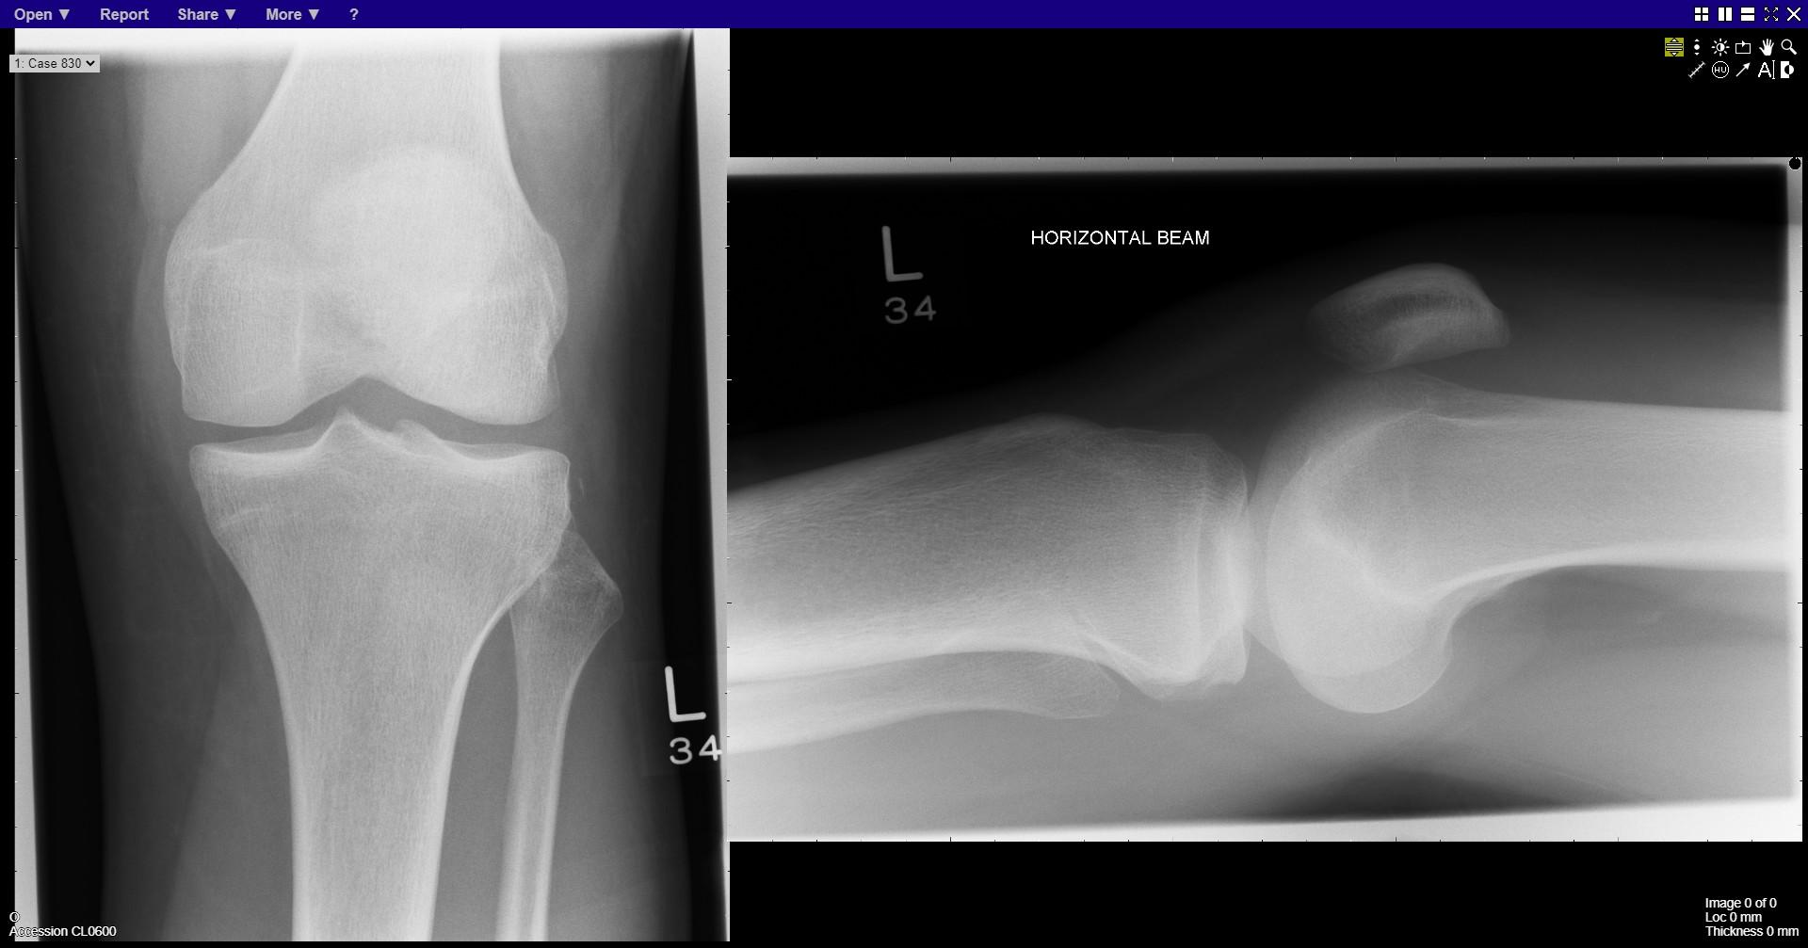
Notes:
Segond fracture

Slide 21
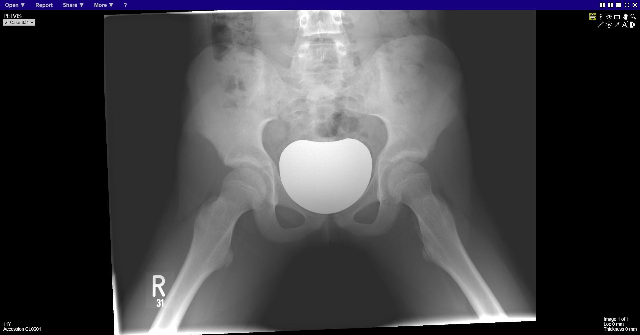
Notes:
normal

Slide 22
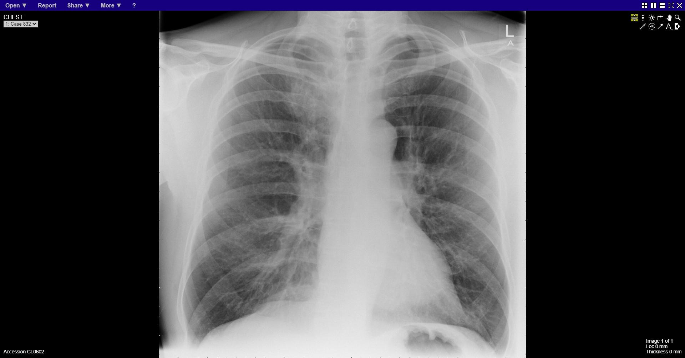
Notes:
Right upper lobe mass

Slide 23
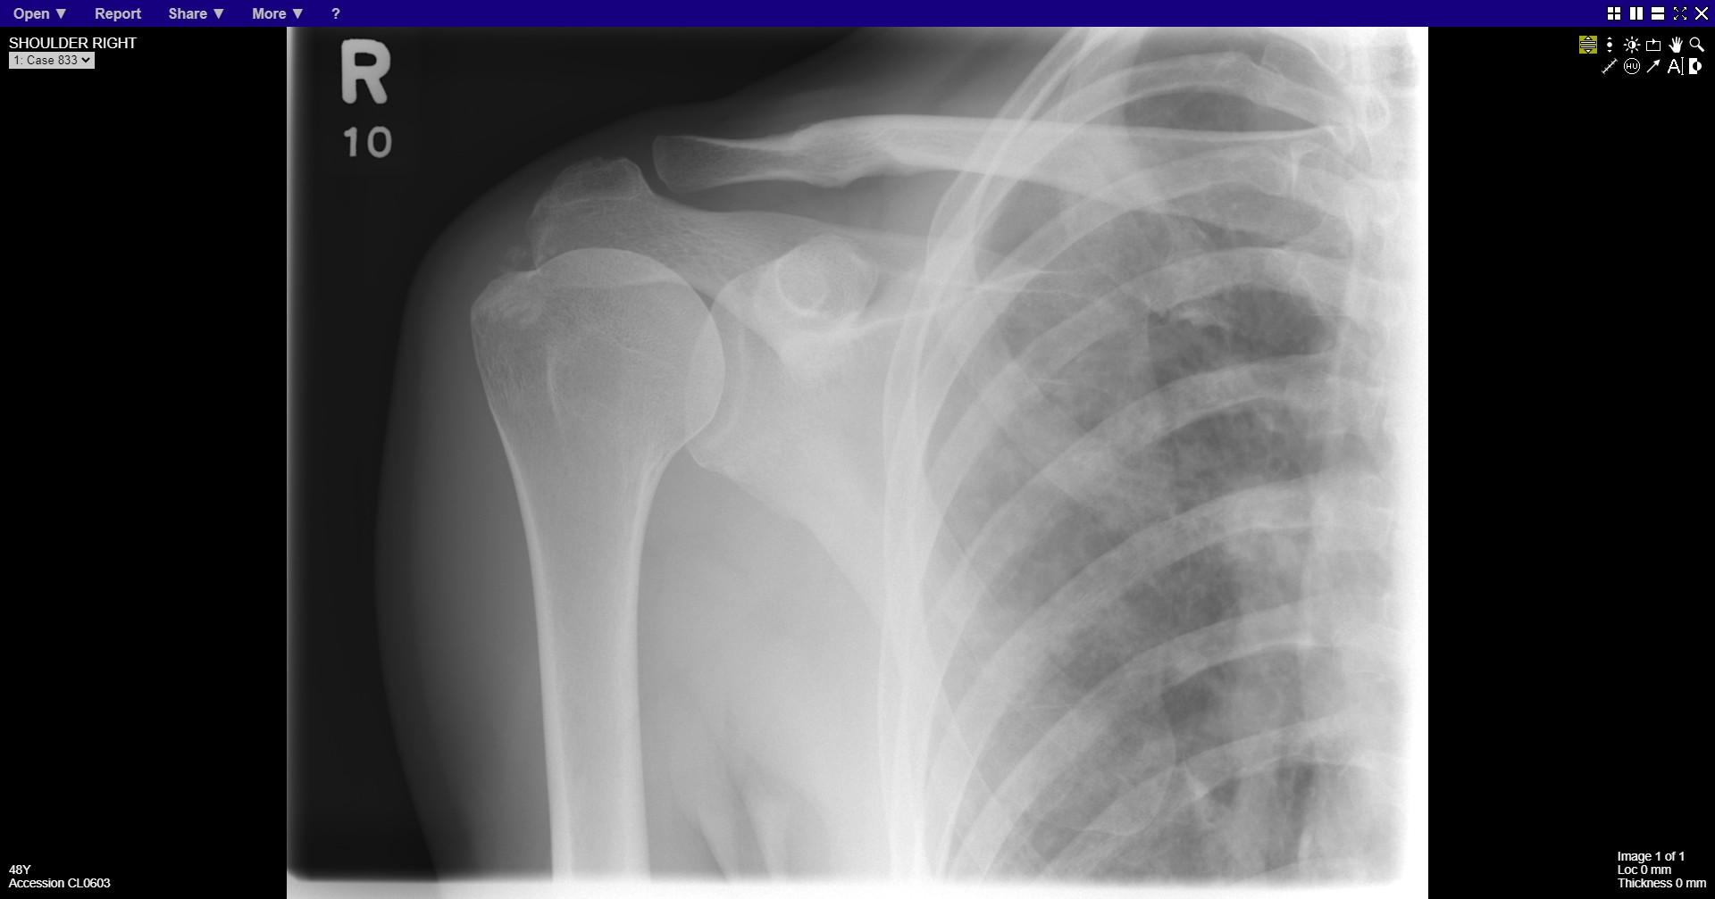
Notes:
Supraspinatus calcification
Nodular interstitial shadowing in the imaged lung

Slide 24
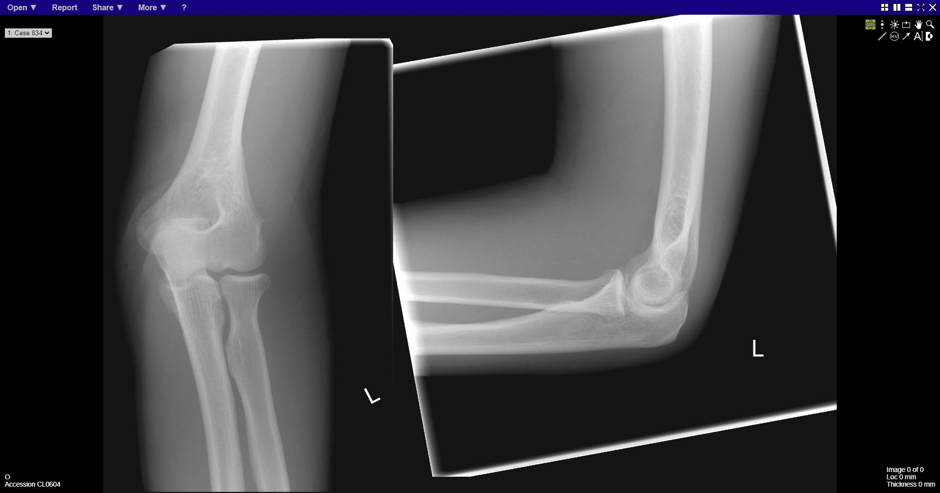
Notes:
normal

Slide 25
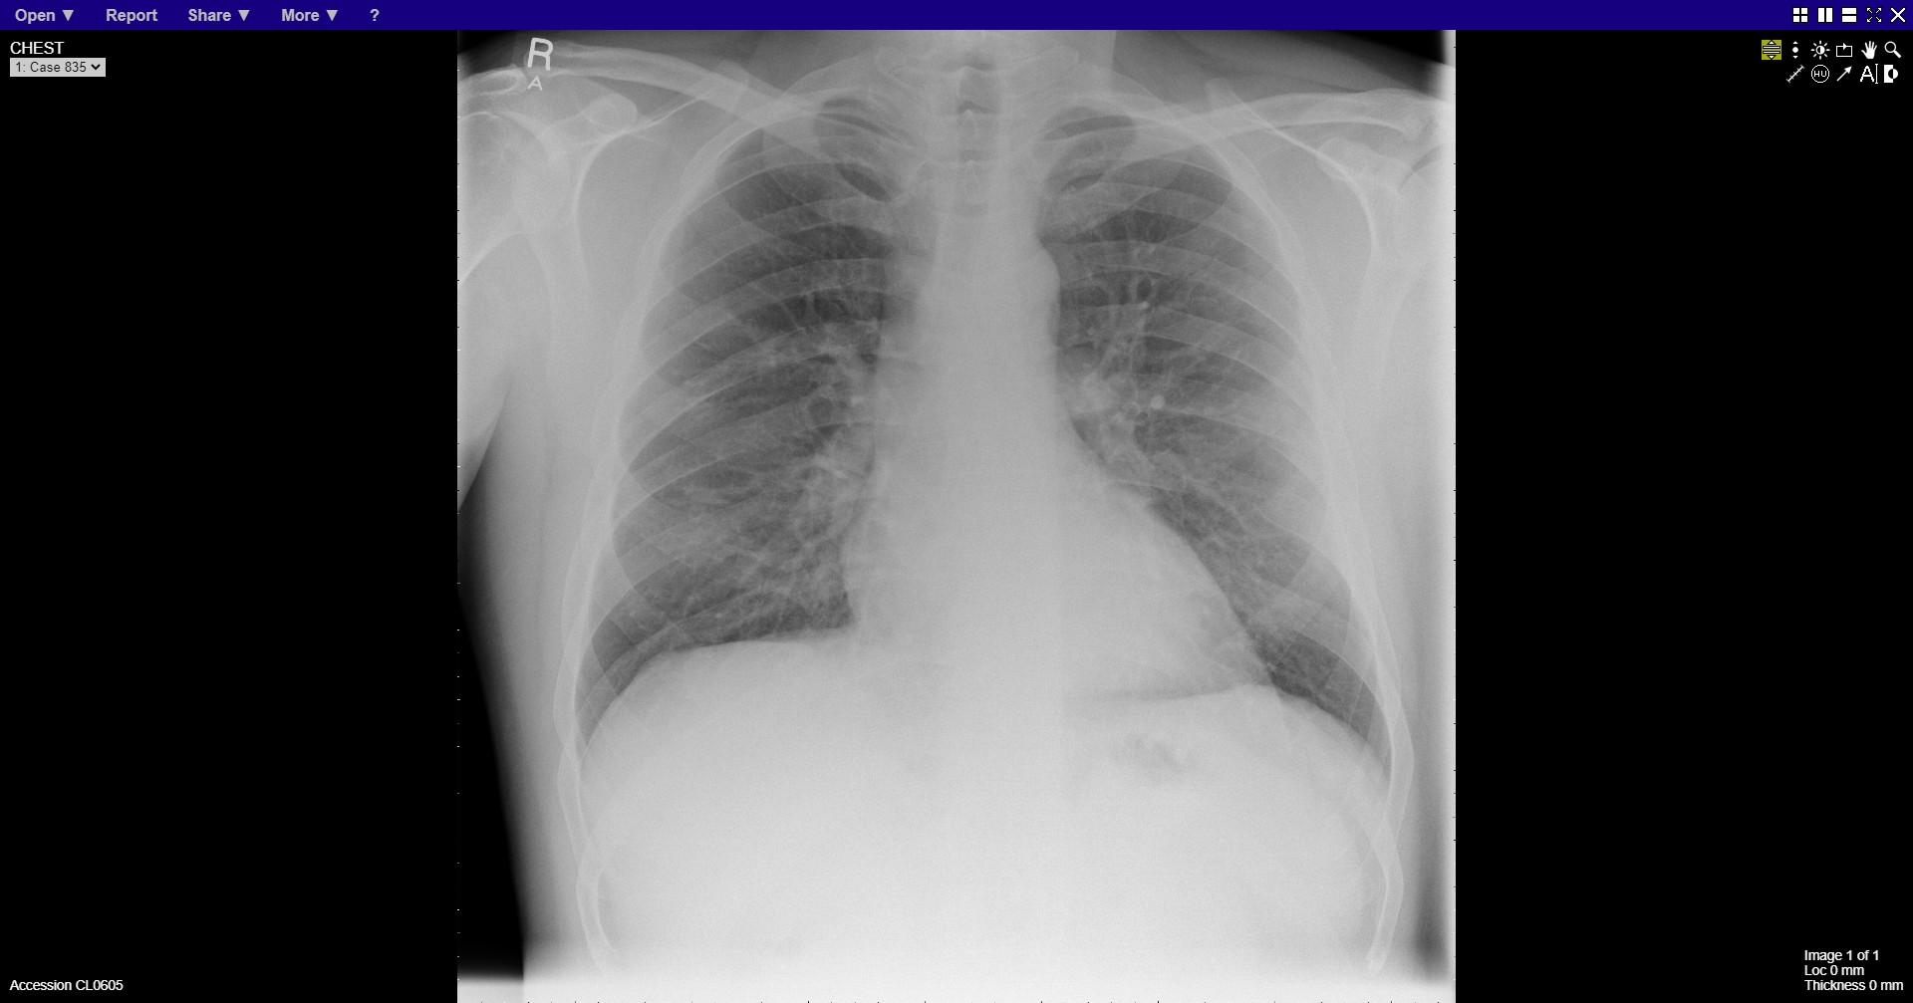
Notes:
Left 7th rib fracture

Slide 26
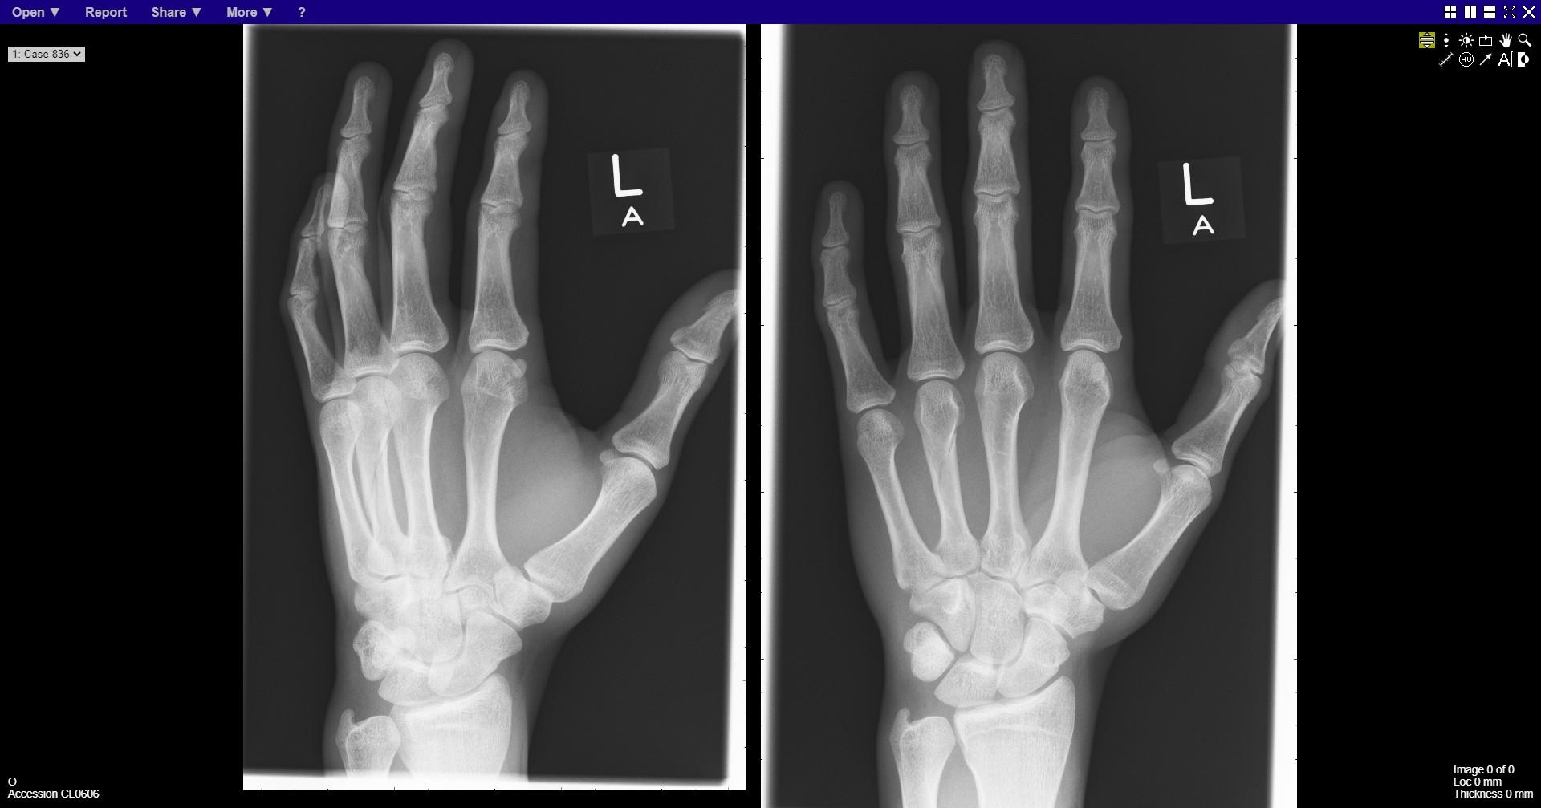
Notes:
Fracture 4th metacarpal

Slide 27
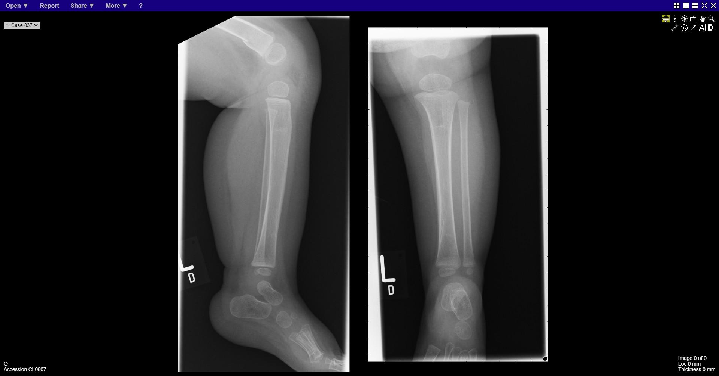
Notes:
Fracture distal femur

Slide 28
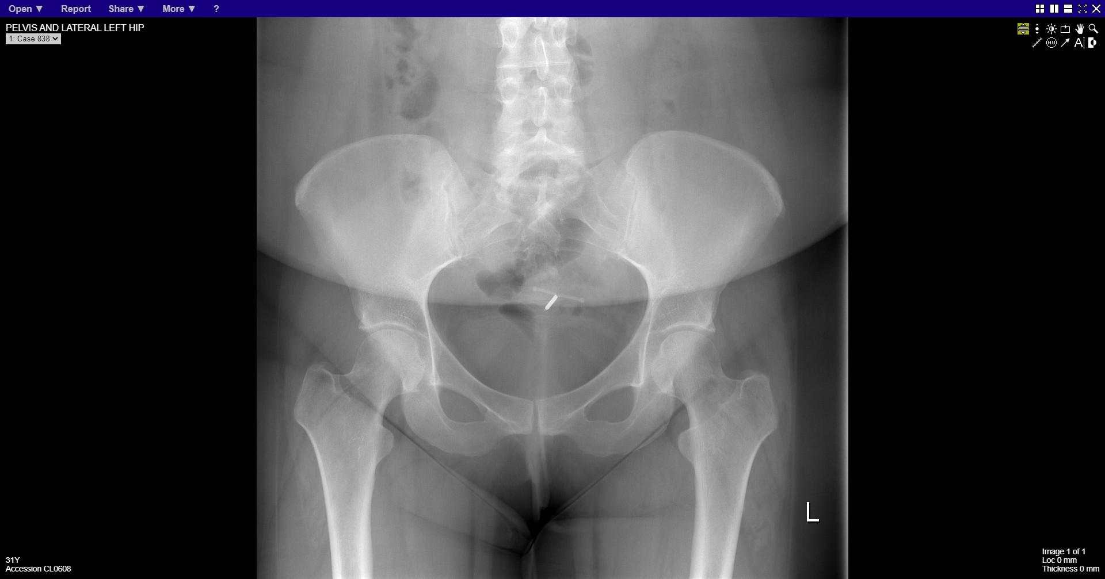
Notes:
normal

Slide 29
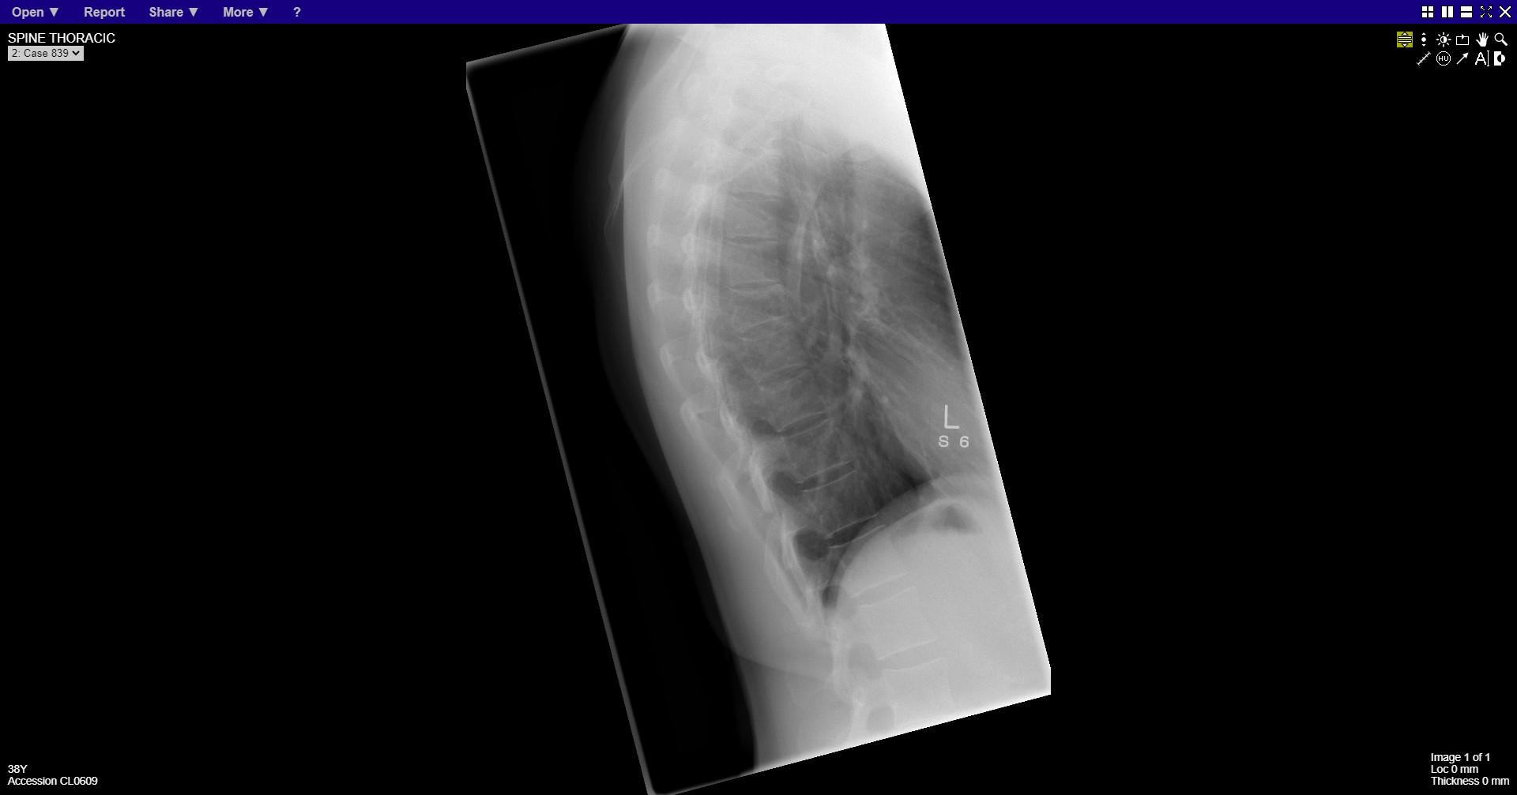
Notes:
Mid thoracic vertebral wedge compression fracture

Slide 30
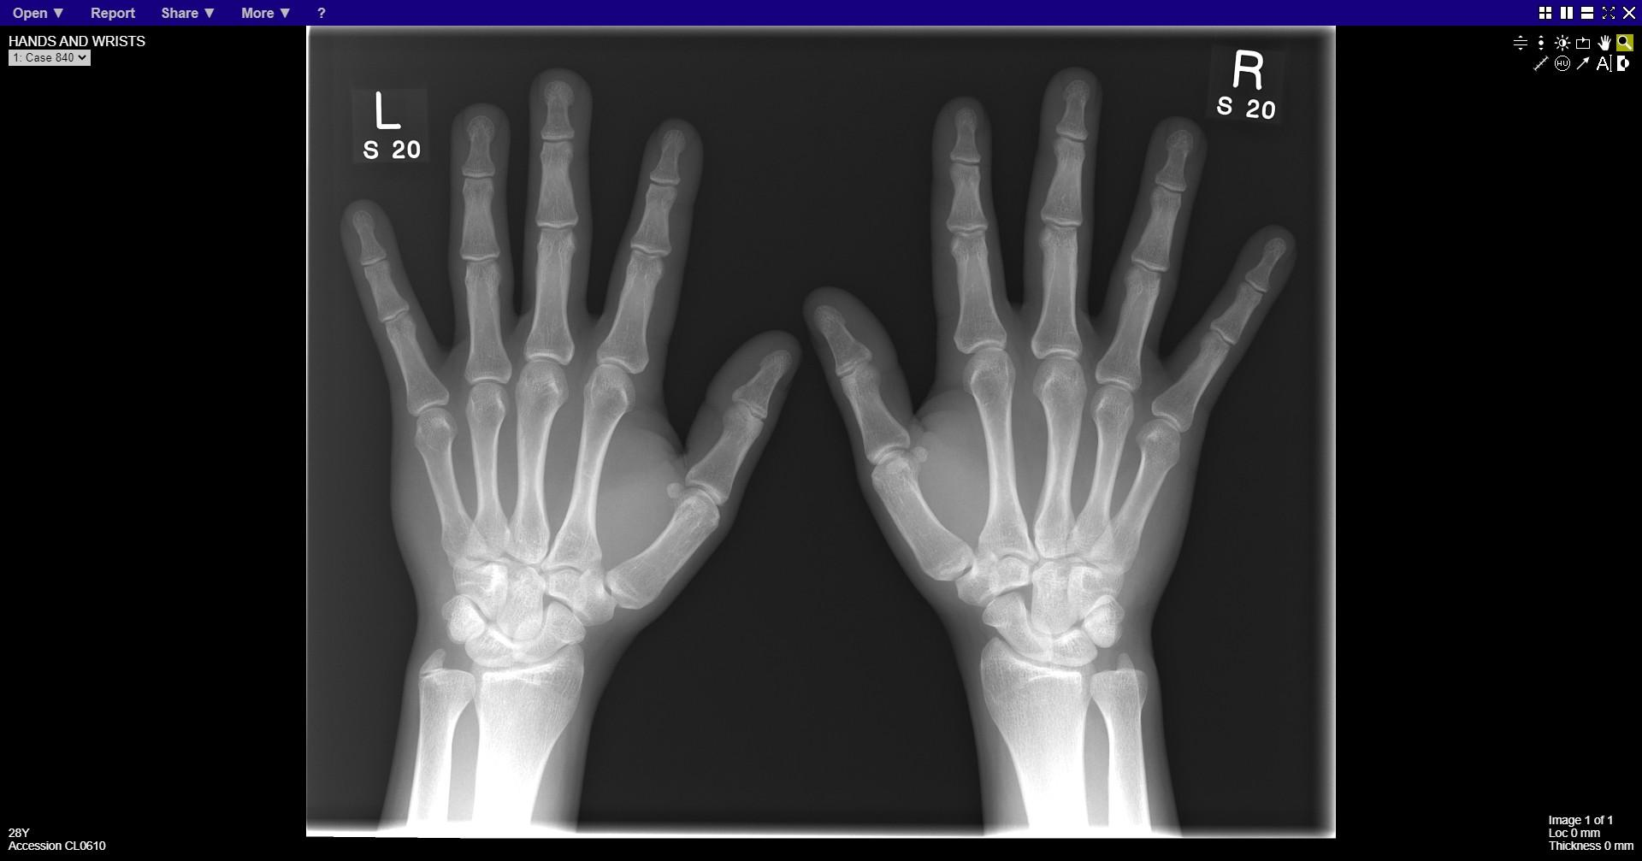
Notes:
Normal
Normal variant – os ulnar styloid

